Slide 1
Ubuntu Bug Triaging
  Ubuntu Maryland LoCo Team
  Presents
  Global Bug Jam February 2009
  This work is licensed under a Creative Commons Attribution-Share Alike 3.0 United States License
Notes:
Created for the Ubuntu Global Bug Jam Aug 2008 by Chuck Frain of the Ubuntu Maryland Team

Slide 2
Ubuntu Bug Triaging
  First Things First
  How Do I Report Bugs?
  What is bug triaging?

Slide 3
First Things First
Why report & triage bugs?
Launchpad Account
Read The 'Code of Conduct'
Know When To Ask For Help
Notes:
Why report & triage bugs
You contribute back to Ubuntu & projects
better products that you use daily
Helps developers focus on actual issues
Launchpad Account
Needed for participating
Makes you known to the community
Read CoC
Understand how the community works together
learn how you are expected to interact
Know when to ask for help
We all need help
No shame in not knowing what you don't know
You get to learn something

Slide 4
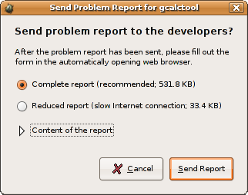
How Do I Report Bugs?
Apport
  Help → Report A Problem
  After A Crash
bugs.launchpad.net
bugs.launchpad.net/ubuntu/+source/appname
Notes:
An overview of different ways to report bugs
[more details in coming slides]

Slide 5
What Is Apport?
Intercepts crashes right when they happen the first time
Gathers potentially useful information about the crash and the OS environment
Can be automatically invoked for other problems that can be automatically detected (e.g. Failed installs)

Slide 6
What Is Apport?
Presents a UI that informs the user about the crash and instructs them on how to proceed
Is able to file non-crash bug reports about software, so that developers still get information about package versions, OS version etc.

Slide 7
Bugs.Launchpad.net
Notes:
Bug Tracking Page
Make mention of always searching for duplicate bugs first
Describe what is on the page

Slide 8
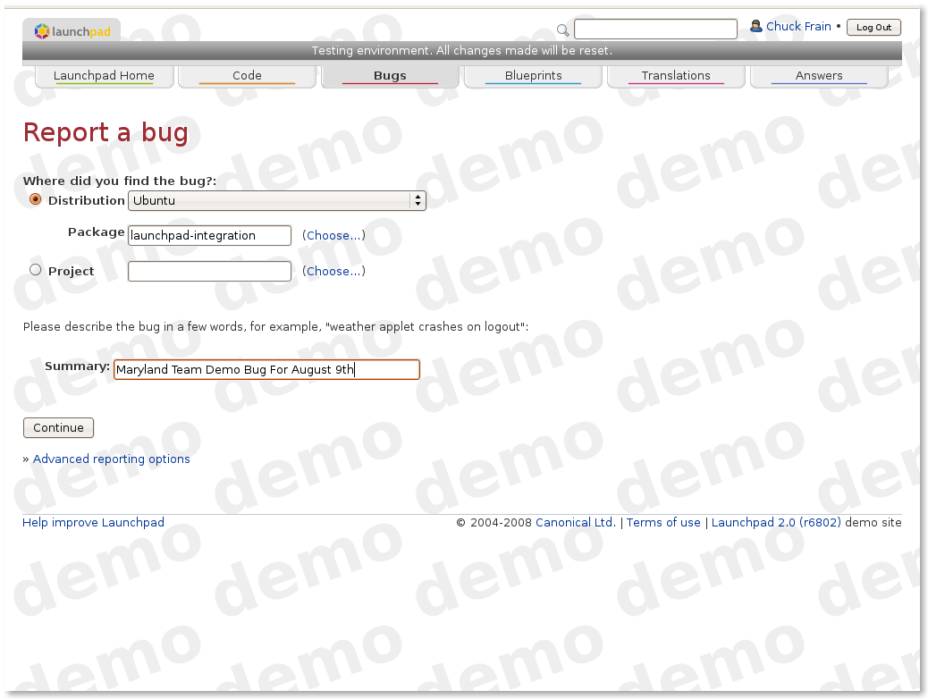
Report A Bug VIA Launchpad

Slide 9
Report A Bug VIA Launchpad

Slide 10
Report A Bug VIA Launchpad

Slide 11
Report A Bug VIA Launchpad

Slide 12
bugs.launchpad.net
Most Packages In The Ubuntu Repositories Have A Launchpad Page
Many projects are chosing to use Launchpad for hosting, bug reporting, etc
Upstream projects are synching to or utilizing Launchpad's bug reporting

Slide 13
What Is Triaging
Is this a duplicate?
Review the bug report
Is this user error or a bug?
Can this be reproduced?
Advanced Triaging
Notes:
[Slides to come on these topics]

Slide 14
Is This A Duplicate?
Search for the same or similar keywords
Has it been reported before?
Mark as duplicate of $BUG if applicable

Slide 15
Review The Bug Report
Release(s) of Ubuntu affected by the bug
Architecture(s) affected by the bug
Version(s) of the package(s) affected by the bug
Steps to reproduce the bug

Slide 16
User Error, Feature, Or A Bug?
Is the user simply doing something wrong?
Is this actually the way the program is supposed to work?
This is an actual problem that needs to be fixed.

Slide 17
Can You Reproduce This Bug?
Run the steps to reproduce
Add aditional detail if discovered
Check and/or set the priority
Confirm the bug report

Slide 18
Advanced Triaging
Sending bugs to theupstream project
Cross-referencing bugs from other distributions.
Expiring old bugs.
Analyzing Crash Reports
Notes:
Otherwise known as 'Going the extra mile'

Slide 19
Resources
https://wiki.ubuntu.com
    /bugs
    /Bugs/CommonTasks
    /Bugs/HowToTriage
    /Bugs/Teams
    /Bugs/Responses
    /DebuggingProcedures
    /HelpingWithBugs
    5-A-Day
help.ubuntu.com/community/ReportingBugs

Slide 20
Thanks For The Help
  Remember that bug reporting and triaging makes your computer better.
  Presented by:
  Chuck Frain
  Ubuntu Maryland LoCo Team

